Slide 1

Note: The data and information in this document is reflective of a hypothetical situation and client. This document is to be used for KPMG Virtual Internship purposes only.
Sprocket Central Pty Ltd
Data analytics approach
Ankita Patnaik

Slide 2
Note: The data and information in this document is reflective of a hypothetical situation and client. This document is to be used for KPMG Virtual Internship purposes only.
Agenda
Introduction
Data Exploration
Model Development
Interpretation

Slide 3
Identify & Recommending High Value Customers
Note: The data and information in this document is reflective of a hypothetical situation and client. This document is to be used for KPMG Virtual Internship purposes only.
Introduction
Outline Of Problem
Sprocket Central Pty Ltd is a company that specializes in high-quality bike and accessories.
The Marketing team is looking to boost sales.
To target 1000 new customers that will bring the highest value to the business
Approach for Data Analysis
Bike Related Purchases for the last 3 Years based on Gender.
Top Industries contributing the maximum profit and bike related sales.
Wealth Segment by Age Category.
Number of Cars Owned in each state.
Customer Classification.

Slide 4
Note: The data and information in this document is reflective of a hypothetical situation and client. This document is to be used for KPMG Virtual Internship purposes only.
Data Exploration
Pl Data Quality Assessment
Key issue dealt with for the data quality issue :
Worksheet | Accuracy | Completeness | Consistency | Currency | Relevancy | Validity
Customer Demographic | DOB : Inaccurate Age : Missing | Job Title : Blanks Customer ID : Incomplete | Gender : Inconsistent | Deceased Customer : Filtered out | Default Column : Removed
Customer Address |  | Customer ID : Incomplete | States : Inconsistent
Transactions | Profit : Missing | Customer ID : Incomplete Online Orders : Blanks Brands : Blanks |  |  | Cancelled Status Order : Filtered Out | List Price : Format Product Sold Date : Format

Slide 5
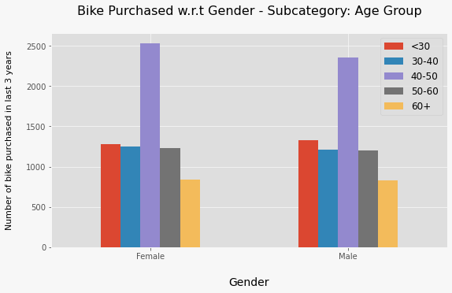
Note: The data and information in this document is reflective of a hypothetical situation and client. This document is to be used for KPMG Virtual Internship purposes only.
Data Exploration
Bike Related Purchase Over The last 3 Years Based On Gender
The target audience for our marketing and advertising should be inclined to provide focus on females than males

Slide 6
Note: The data and information in this document is reflective of a hypothetical situation and client. This document is to be used for KPMG Virtual Internship purposes only.
Data Exploration
Top Job Industry Contributing to the Maximum Profit & Bike Related Purchases
The Top 3 Industry Sector bringing Highest Profit : Manufacturing , Financial Services & Health.
Reason is obvious as most of these industries would be within the city or on the outskirts so usage of bikes are more by the consumers.

Slide 7
Note: The data and information in this document is reflective of a hypothetical situation and client. This document is to be used for KPMG Virtual Internship purposes only.
Data Exploration
Profit of Wealth Segment by Age Cluster
Overall, the Mass customer segmentation makes the highest profit across the different age clusters.
Mass Customer Aged between 38-47 are likely to bring more profit for the company compared to other age clusters.
This also indicates a trend of buying power, as the buying power increases over time till 47 years then gradually profit decreases.

Slide 8
Note: The data and information in this document is reflective of a hypothetical situation and client. This document is to be used for KPMG Virtual Internship purposes only.
Data Exploration
Number of Cars Owned in each State
NSW, QLD & VIC could be potential market opportunities for the company.
NSW, has the highest potential as the number of people that own car is almost equal to the people who don’t own cars which shows that there is opportunity to find value customers there.

Slide 9
Note: The data and information in this document is reflective of a hypothetical situation and client. This document is to be used for KPMG Virtual Internship purposes only.
Model Development
CUSTOMER CLASSIFICATION – Targeting High Value Customers
The following are the high-value clients to target from the new list :
Aged between 38-47.
Most of the high value customers are female compared to male
Working in Financial Service, Manufacturing and Health.
Who are currently living in New South Wales and Victoria.

Slide 10
Interpretation
HIGH-VALUE CUSTOMER SUMMARY TABLE
Customer ID | Bike Related Purchases for the last 3 years | Age | Job Industry | Wealth Segment | Owns Cars | State
1842 | 445 | 44 | Financial Services | Mass Customer | No | New South Wales
2001 | 168 | 44 | Manufacturing | Mass Customer | Yes | New South Wales
650 | 486 | 44 | Health | Mass Customer | No | New South Wales
3297 | 234 | 46 | Manufacturing | Mass Customer | No | Victoria
50 | 266 | 41 | Manufacturing | Mass Customer | Yes | New South Wales

Slide 11
Note: The data and information in this document is reflective of a hypothetical situation and client. This document is to be used for KPMG Virtual Internship purposes only.
THANK YOU

